Slide 1
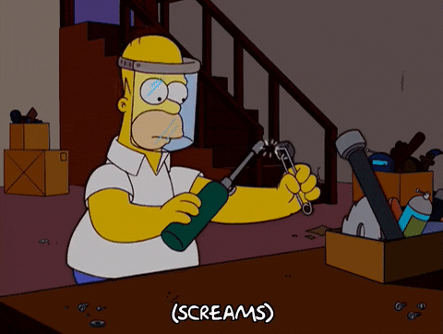
FIRE SAFETY
Operating Room Suite

Slide 2
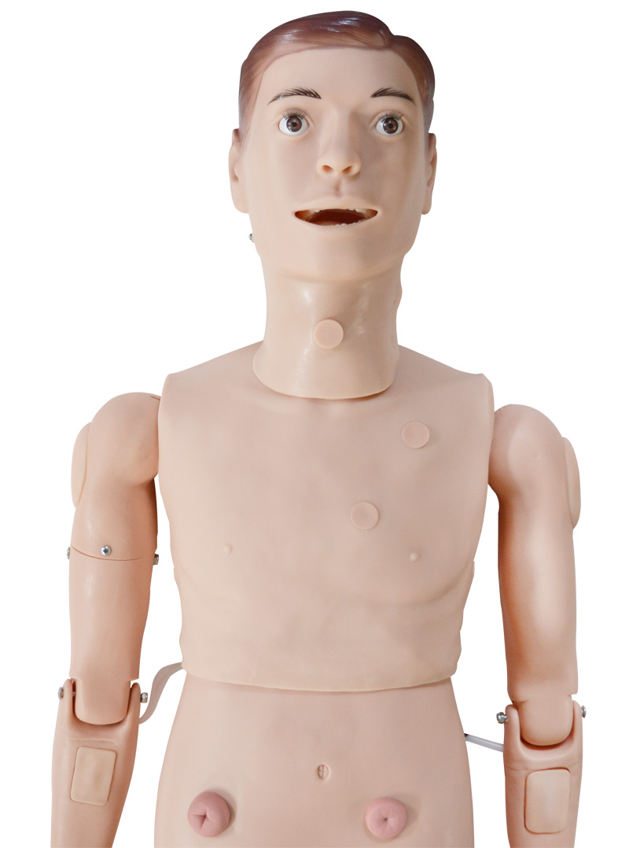
A SURGICAL FIRE…
Is a fire in, on, or around a patient who is undergoing a medical or surgical procedure
Is considered a sentinel event & preventable
65% of surgical fires occur on the head, neck, face and upper trunk

Slide 3
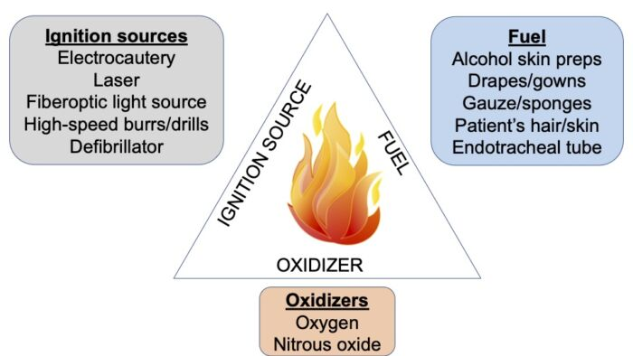
SURGICAL FIRE TRIANGLE
3 Main Contributing Factors

Slide 4
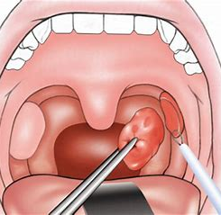
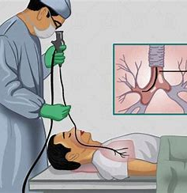
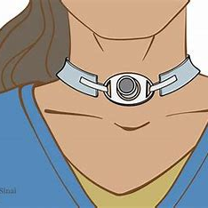

Room air can be used in surgeries such as:
Tracheostomies
Tonsillectomies
Bronchoscopies

Slide 5
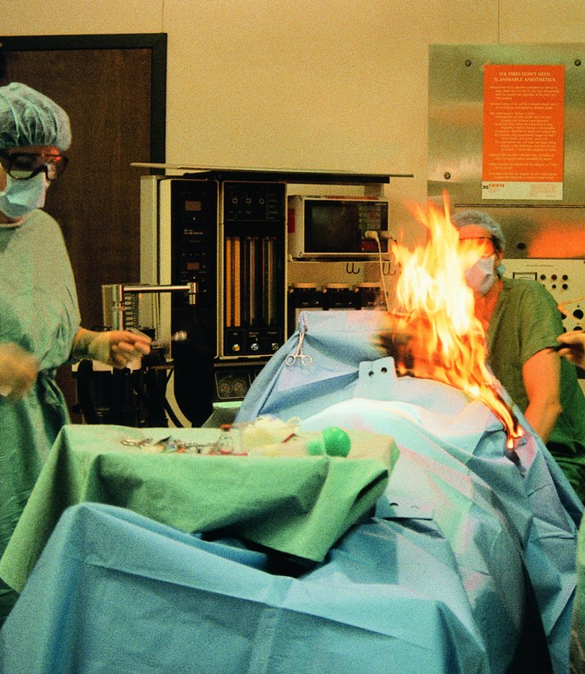
Flash Fire
30% O2 needed to start a flash fire
Clinicians can reduce the risk of surgical fires by maintaining oxygen levels below 30%
Minor elevations in oxygen concentration as a result of supplemental oxygen and/or surgical drapes result in an astronomically increased risk for fire.
Notes:
Operating Room Fires | Anesthesiology | American Society of Anesthesiologists (asahq.org)

Slide 6
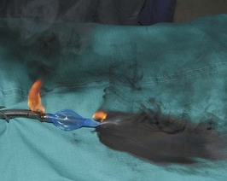
Flash Fire
Reduce risk by:
Blending oxygen with room air to decrease the concentration of oxygen delivered to the patient
Diluting the under drape area space with air via the anesthesia circuit
Using modified draping techniques that allows for increased air flow in the under drape area.
Notes:
Operating Room Fires | Anesthesiology | American Society of Anesthesiologists (asahq.org)

Slide 7
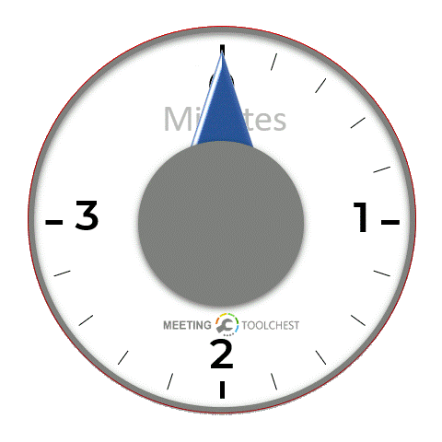
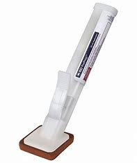
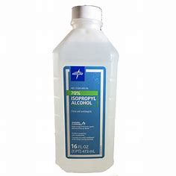
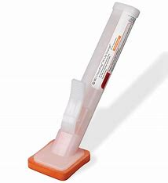
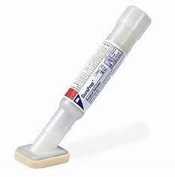
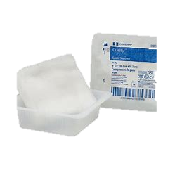
WAITING GAME
Wait to drape or start surgery at least
3 minutes or until the alcohol-based prep is dry to help minimize the risk for surgical fire

Slide 8
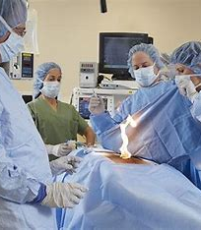
IF A SURGICAL FIRE STARTS…
Immediately shut off all oxygen/nitrogen supply to the patient
Immediately remove burning drapes from the patient and douse the fire and the patient with saline to put the fire out.
Use a fire extinguisher on the drapes if necessary

Slide 9
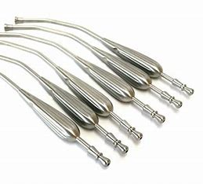
PREVENTING FIRES IN THE OROPHARYNX…
decrease oxygen concentration below 30%
suction oropharynx before using electrocautery device
use metal suction device instead of plastic one.

Slide 10
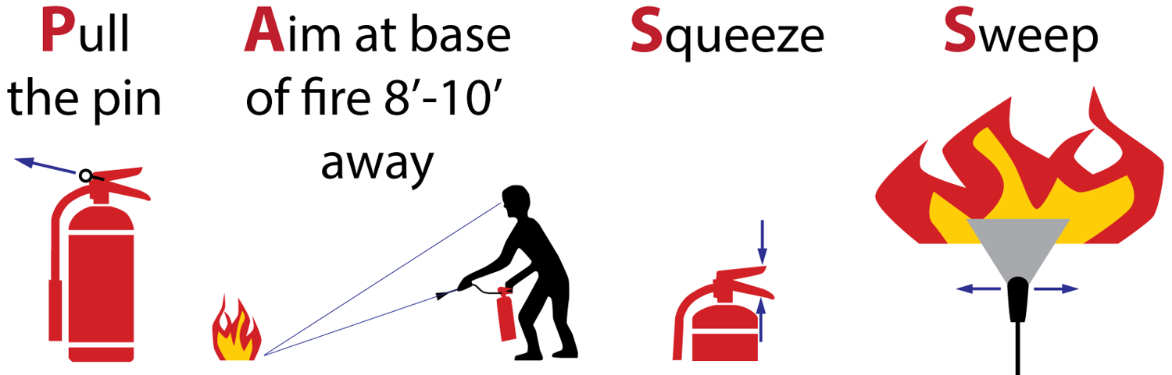
P.A.S.S
PASS is a mnemonic used to remember the four basic steps for using a fire extinguisher
Pull the pin
Aim at the base of the fire
Squeeze the handle of the extinguisher
Sweep back and forth until the fire is extinguished

Slide 11
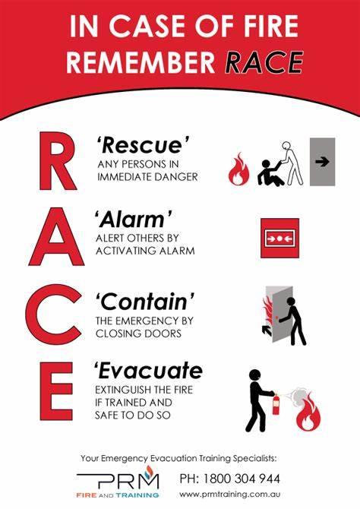
R.A.C.E
In case of a fire, you should follow the R.A.C.E. fire procedure
Rescue/Remove: Rescue or remove any persons from the immediate scene.
Alert/Activate: Pull the nearest alarm and call 2000.
Confine: Close all doors to the hazard or fire area.
Extinguish/Evacuate: Extinguish the fire using a fire extinguisher or evacuate the area

Slide 12
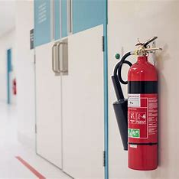
O.R. FIRE EXTINGUISHER LOCATIONS
MAIN OR:
Next to the elevator that goes up to the overflow supply room
Outside room 9 next to the exit stairwell
Outside room 7 next to the main pyxis room
Next to the stairwell by the c.v. room
Main OR doors left side on the wall
WSOP OR:
Outside Room 2 by pyxsis

Slide 13
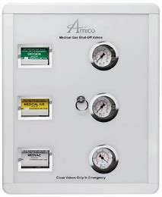
MEDICAL GAS SHUT OFF VALVE LOCATIONS
Outside each OR room on the wall

Slide 14
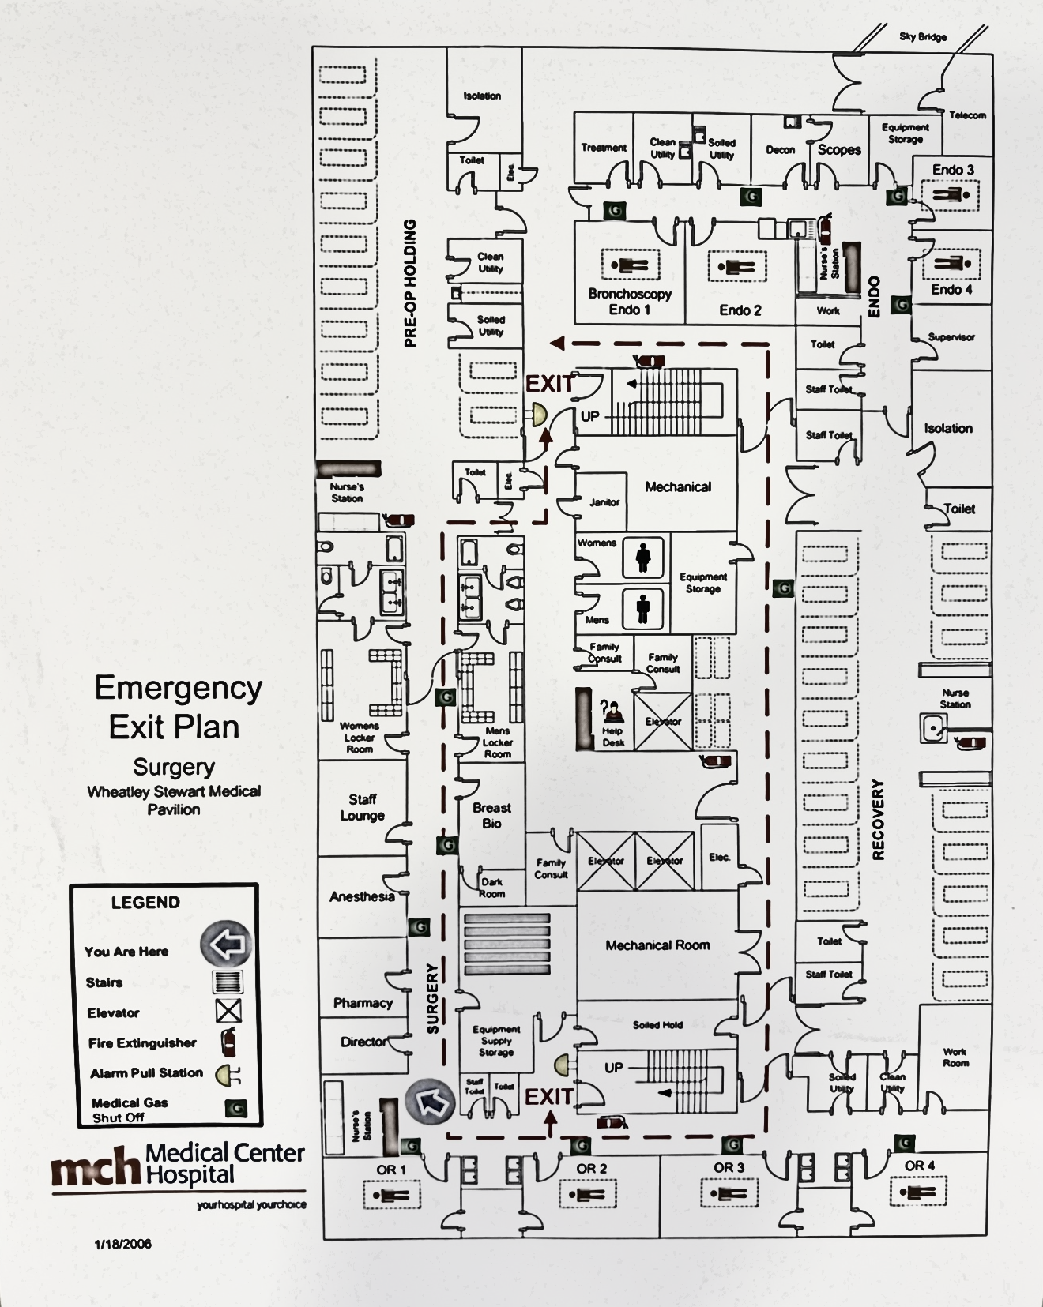
WSOP EMERGENCY EXIT

Slide 15
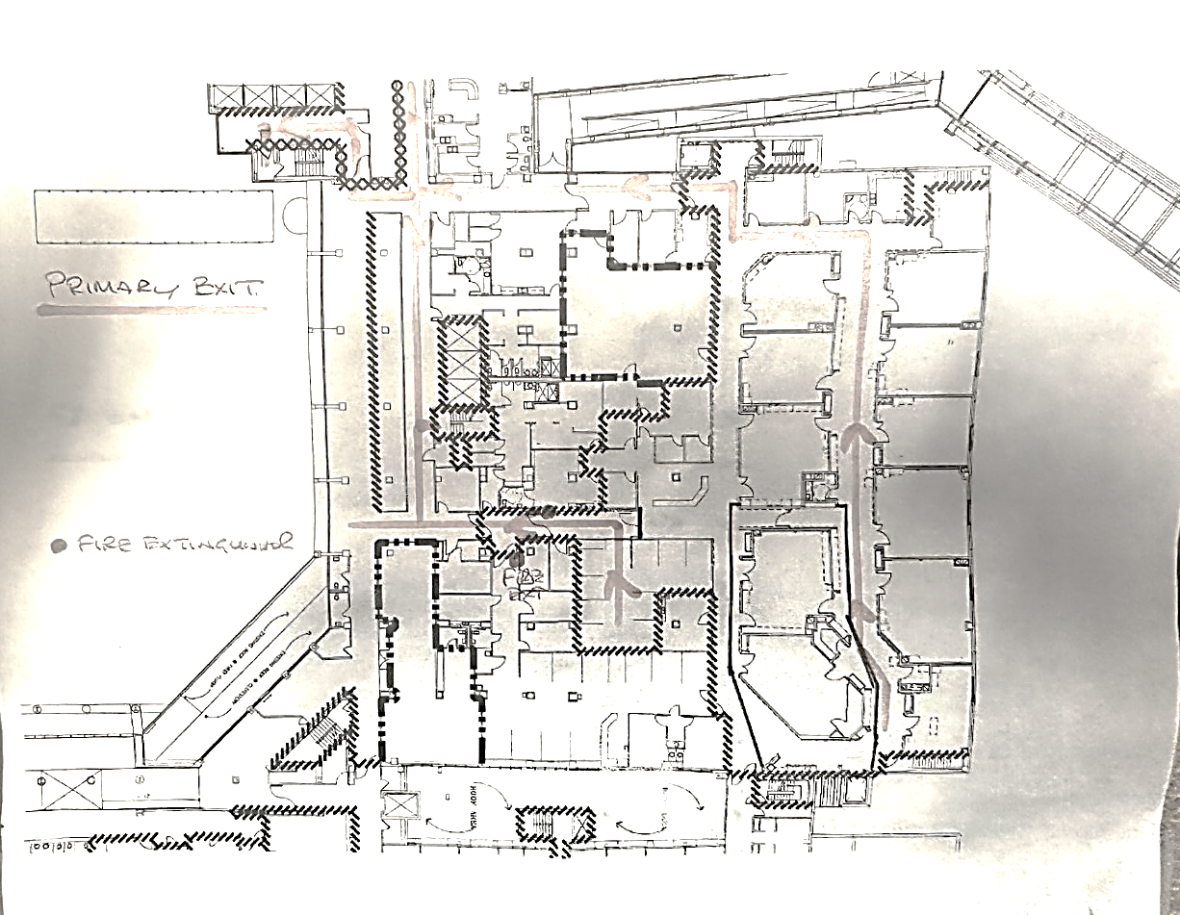
MAIN OR EMERGENCY EXIT

Slide 16

SEE SOMETHING SAY SOMETHING
Each member of the surgical team is responsible for assessing all hazards that could contribute to a surgical fire, as well as observing the action of all other team members and speaking up immediately if any preventive risk or evidence of a possible fire is observed.

Slide 17
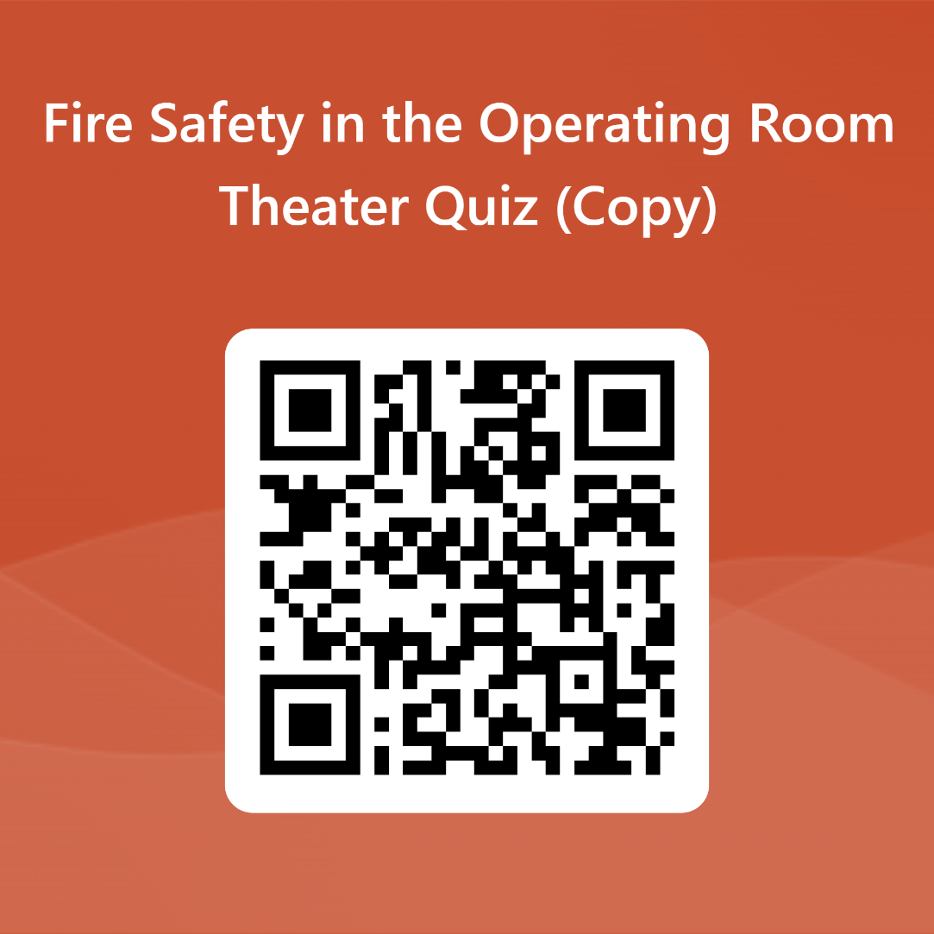
Continue to the Test
Link
https://forms.office.com/r/Vvx91DXLj9

